Slide 1
The Science and Practice of Treating Patients with Pain and Opioid Use Disorders (OUD)
Christina Lasich, MD
Chief Medical Officer, Western Sierra Medical Clinic
UCLA Integrated Substance Abuse Programs &
California Primary Care Association
October 11, 2018

Slide 2
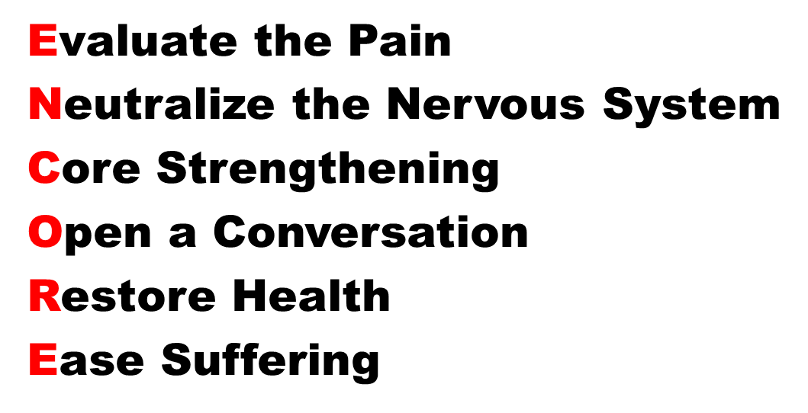
ENCORE: The Treatment of Pain and Opioid Use Disorder

Slide 3
Learning Objectives
Improve ability to evaluate and categorize pain in order to provide non-opioid solutions and reduce reliance on opioids
Learn how to have a conversation about functional goals and expectations during the treatment of chronic pain
Discover ways to use health and suffering as treatment doorways for both pain and addiction

Slide 4

Disclosures
Nothing to disclose but much is to be revealed….

Slide 5
A Tale of Two Epidemics
Chronic Pain
Opioid-Overdose Deaths

Slide 6
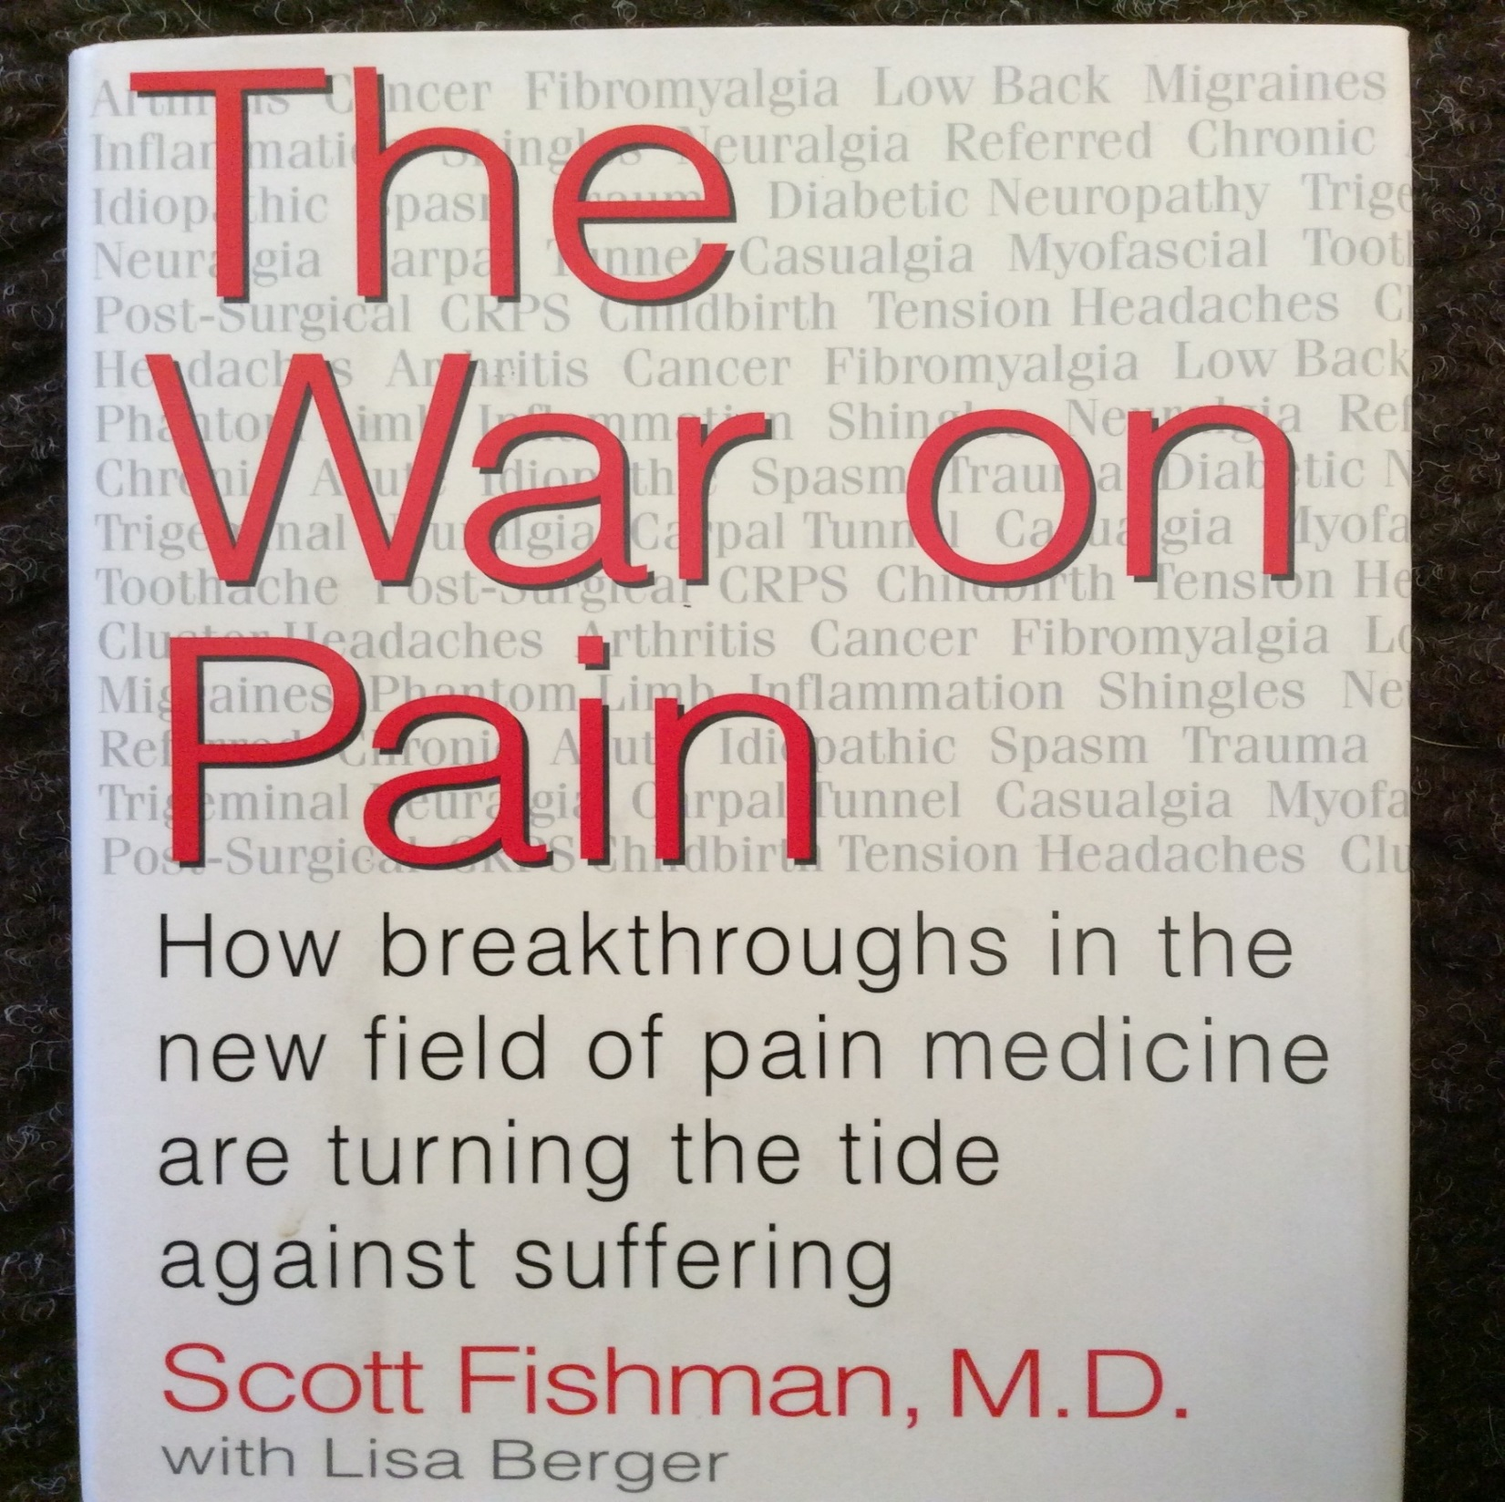
The War on Pain
First came…

Slide 7
Then Doctors were Sued or Disciplined for Poor Pain Control
1999 Oregon doctor disciplined by Oregon Board of Medical Examiners for failing to proved adequate pain management
2002 Bergman v. Chin: Dr. Chin ordered to pay $1.5 million for undertreating pain

Slide 8
Next Came..
Next came..
The Exponential increase of Prescriptions for opioids from
Late ‘90’s to Present

Slide 9
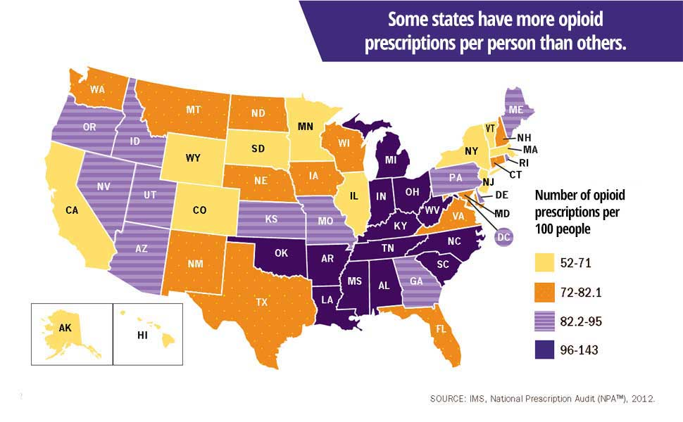
Opioid Prescriptions Per 100 People

Slide 10
Opioid Overdose Deaths
Now we are seeing
an exponential increase in opioid overdose deaths from 2000 to 2015

Slide 11
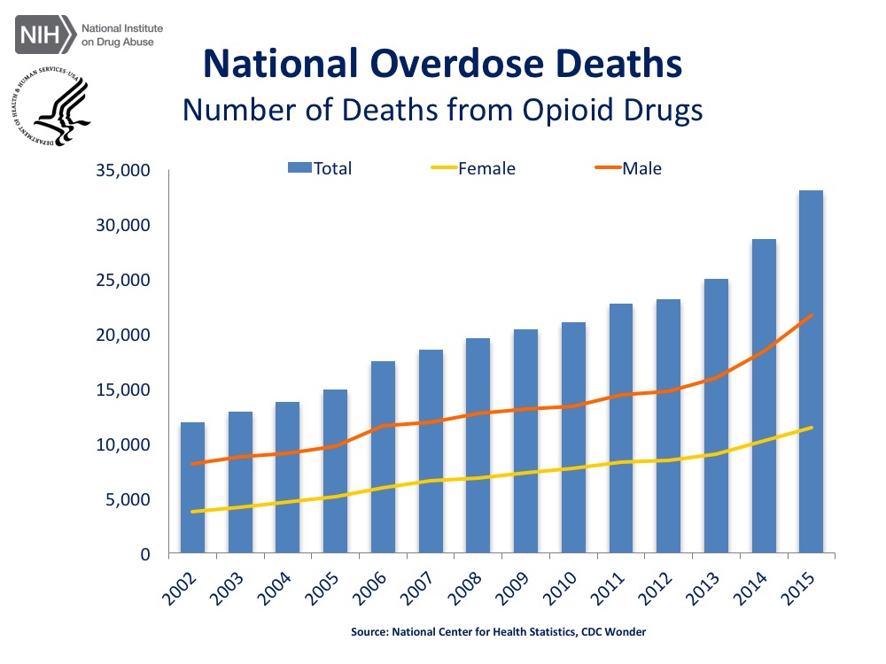
National Overdose Deaths

Slide 12
Chronic pain and overdose deaths
How do we stop both the epidemic of chronic pain and opioid-overdose deaths?

Slide 13
Case of Opioid PLUS Benzodiazepine Dependency
53 year old woman with lumbar pain following lumbar discectomy with laminectomy presents to you because of worsening pain and to establish care. She is currently taking hydrocodone/APAP 10/325 tablet every 4 hours (6/day) and has been taking it for over 5 years. Two years ago she began taking alprazolam 0.5mg three times per day for anxiety as prescribed by previous primary provider. She is also using zolpidem 10mg at bedtime. Her CURES report shows that hydrocodone is frequently filled a week early. Her urine drug test is consistent accept for positive test result for oxazepam. When questioned, she admits to using a friends diazepam when she ran short of her medications. Her pain has been a 9/10 lately and she is feeling depressed.

Slide 14
How do we support an opioid taper in someone that has chronic pain?
Without:
  Losing Function
  Losing the Therapeutic Alliance
  Losing Hope

Slide 15
Ask for an ENCORE and bring alternatives to opioids back into the practice of medicine
Evaluate the Pain
Neutralize the Nervous System
Core Strengthening
Open a Conversation
Restore Health
Ease Suffering

Slide 16
ENCORE: Evaluate Pain
What does the pain feel like?
What makes it worse?
What makes it better?
Are there any other abnormal sensations?
Is there a time of day when the pain is worse?
Physical exam!!

Slide 17
Mechanical Pain
Positional, Activity or Functional Dependent Pain
  Examples include: spinal stenosis, neck pain, shoulder tendonitis, knee or hip arthritis
  Solutions include: zero gravity chair, assistive devices, improve the wake and sleep posture, and improve the body mechanics

Slide 18
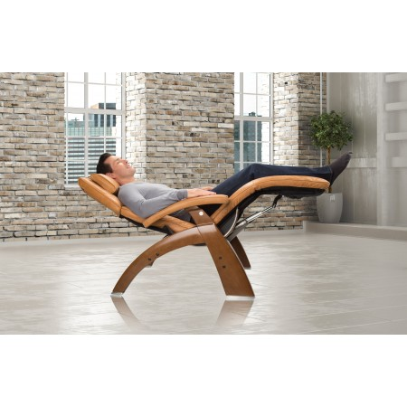
Man in chair

Slide 19
Case of Opioid PLUS Benzodiazepine Dependency Pt. 1
53 year old woman with lumbar pain following lumbar discectomy with laminectomy presents to you because of worsening pain and to establish care. She is currently taking hydrocodone/APAP 10/325 tablet every 4 hours (6/day) and has been taking it for over 5 years. Two years ago she began taking alprazolam 0.5mg three times per day for anxiety as prescribed by previous primary provider. She is also using zolpidem 10mg at bedtime. Her CURES report shows that hydrocodone is frequently filled a week early. Her urine drug test is consistent accept for positive test result for oxazepam. When questioned, she admits to using a friends diazepam when she ran short of her medications. Her pain has been a 9/10 lately and she is feeling depressed.

Slide 20
Neuropathic Pain
Pain that is driven by a sensitive “alarm system”, the peripheral or central nervous system
  Examples include: neuropathy, radiculitis, complex regional pain syndrome, fibromyalgia, AND Opioid-Induced Hyperalgesia
  Solution is to desensitize the nervous system or in other words, “reset the alarm”, “calm the nerves down”…

Slide 21
ENCORE: Neutralize the Nervous System
The Neutralizing Medications: “calm the nerves”
  Beyond Gabapentin is Zonisamide, Topiramate, Tiagabine and Pregabalin
  TCA= Tricyclic Analgesics (amitriptyline, imipramine, desipramine)
  Baclofen, a muscle relaxant and NMDA antagonist
  Buprenorphine!!??!!

Slide 22
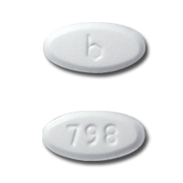
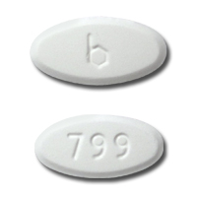
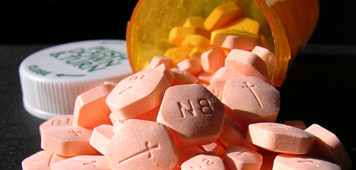
Buprenorphine
Buprenorphine/
Naloxone
Subutex ®
Suboxone ®

Slide 23
Induction Puzzle
The animation
automatically begins.
The Induction Puzzle, Starting Buprenorphine
Without Causing
Precipitated Withdrawals

Slide 24
Puzzle
Patient
Motivated and Able
Pregnant or Not
Drugs
Short or Long Acting Opioids
Patient
Timing
Drugs
Stabilizing
Timing
Opioid-Free or Not
@Home or Not
Stabilizing
With Time
With other Drugs
References:
Journal of Substance Abuse Treatment; “Comparison of Buprenorphine Induction Strategies”; 2011; June; 40(4): 349-356
The New England Journal of Medicine; “Neonatal Abstinence Syndrome after Methadone or Buprenorphine Exposure”; 2010; 363:2320-31

Slide 25
Neutralizing Neural Tension
Stop Stretching or Hanging on the Nerve
  Use arm rests
  Stop using recumbent stationary bicycle
  Stop reaching
Physical Therapy for “Nervous System Mobilization” by “flossing” the nervous system with “gliders” and “sliders”
  Book references by David Butler:

Slide 26
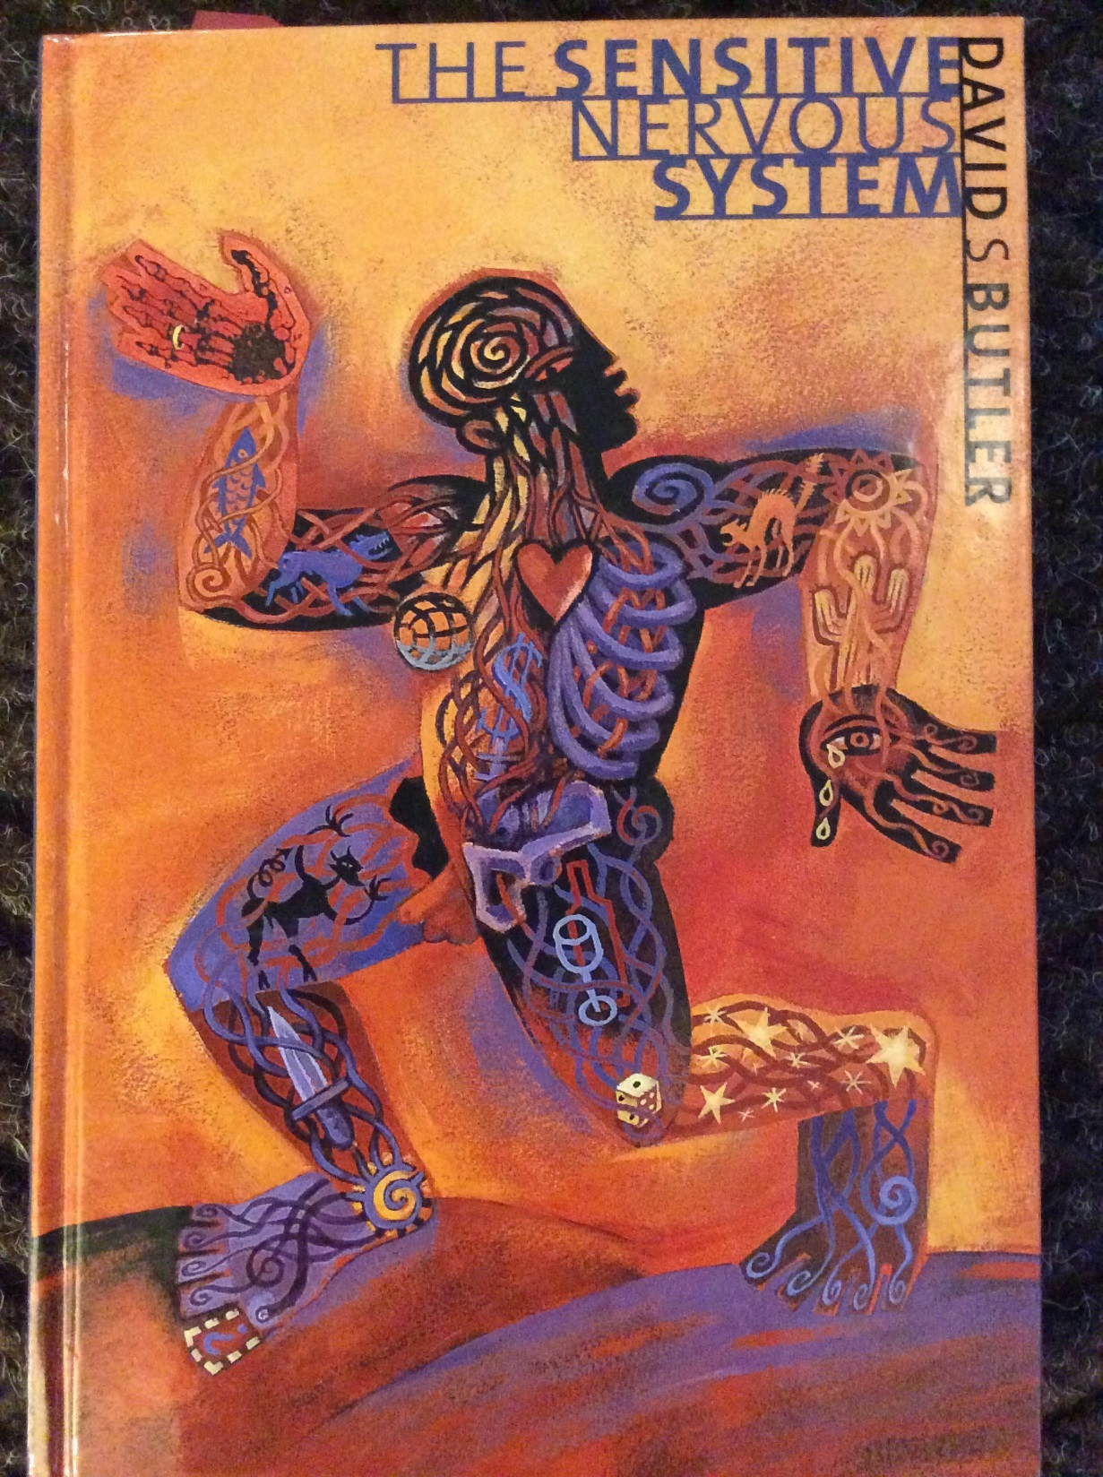
The Sensitive Nervous System

Slide 27
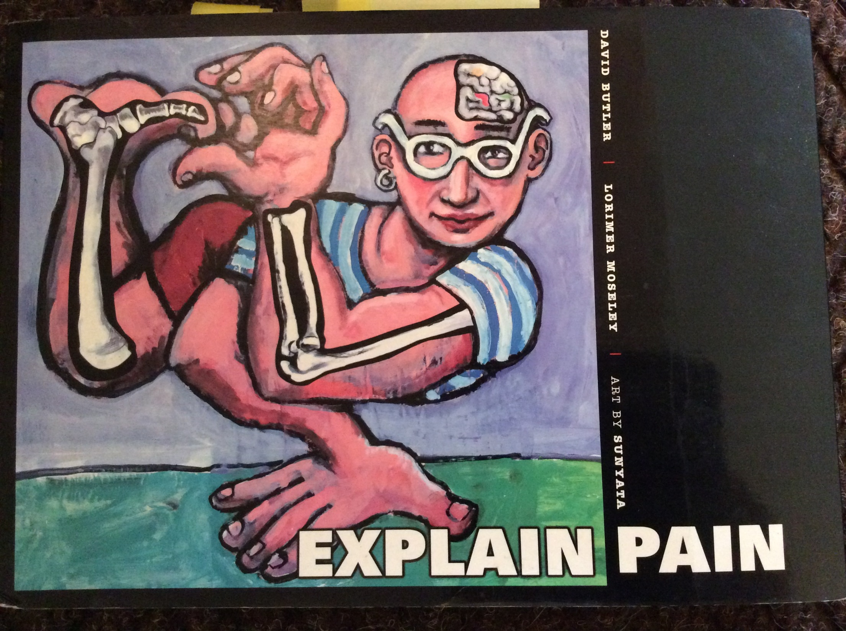
Explain Pain

Slide 28
Case of Opioid PLUS Benzodiazepine Dependency Pt. 2
53 year old woman with lumbar pain following lumbar discectomy with laminectomy presents to you because of worsening pain and to establish care. She is currently taking hydrocodone/APAP 10/325 tablet every 4 hours (6/day) and has been taking it for over 5 years. Two years ago she began taking alprazolam 0.5mg three times per day for anxiety as prescribed by previous primary provider. She is also using zolpidem 10mg at bedtime. Her CURES report shows that hydrocodone is frequently filled a week early. Her urine drug test is consistent accept for positive test result for oxazepam. When questioned, she admits to using a friends diazepam when she ran short of her medications. Her pain has been a 9/10 lately and she is feeling depressed.

Slide 29
ENCORE: Core Strength
Poor Core strength in proximal muscle groups: Rhomboids, Trapezius, Abdominal Wall, and Gluteal Muscles
Poor Core strength causes painful conditions like: “thoracic outlet syndrome”, back and neck pain, trochanteric tendonitis/bursitis, and foot pain (!!?!)

Slide 30
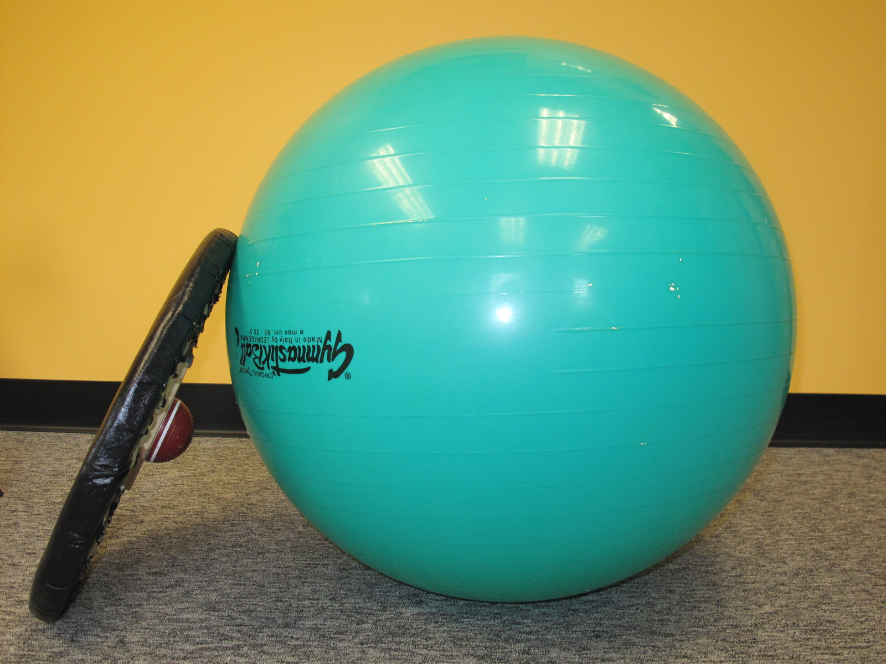
Exercise ball

Slide 31
ENCORE: Open a Conversation
About the expectation to be pain free and to do things the same way
About the functional goals (it’s not about the pain scale)

Slide 32
What are you able to do now with the use of opioids that you were not able to do before?
Sleep better
Return to work
Resume activities of enjoyment
Play with children
Exercise

Slide 33
How can we help you increase your activity level while decreasing the reliance on opioids?
Start with addressing the fear-avoidance behavior by helping patients:
  Learn about the problem
  Explore ways to move
  Explore and nudge the edges of pain
  Stay positive
  Make plans
  Remember that hurt does not always equal harm
*Reference: “Explain Pain” by David Butler

Slide 34
Case of Opioid PLUS Benzodiazepine Dependency Pt. 3
53 year old woman with lumbar pain following lumbar discectomy with laminectomy presents to you because of worsening pain and to establish care. She is currently taking hydrocodone/APAP 10/325 tablet every 4 hours (6/day) and has been taking it for over 5 years. Two years ago she began taking alprazolam 0.5mg three times per day for anxiety as prescribed by previous primary provider. She is also using zolpidem 10mg at bedtime. Her CURES report shows that hydrocodone is frequently filled a week early. Her urine drug test is consistent accept for positive test result for oxazepam. When questioned, she admits to using a friends diazepam when she ran short of her medications. Her pain has been a 9/10 lately and she is feeling depressed.

Slide 35
ENCORE: Restore Health
Pain is a doorway to transformation
Pain is a “signal” from the brain that means something needs to change
Pain is a motivator

Slide 36
Vitamins and Supplements
Vitamin D: Low levels associated with chronic pain and headaches
  Virtanen, J. K. et al. Low serum 25-hydroxyvitamin D is associated with higher risk of frequent headache in middle-aged and older men. Sci. Rep. 7, 39697; doi: 10.1038/srep39697 (2017).
Acetyl-L-Carnitine for Neuropathy
  Sima, AA et al. Acetyl-L-Carnitine improves pain, nerve regeneration, and vibratory perception in patients with chronic diabetic neuropathy: an analysis of two randomized placebo-controlled trials. Diabetes Care, Jan. 28 (1) (2005)

Slide 37
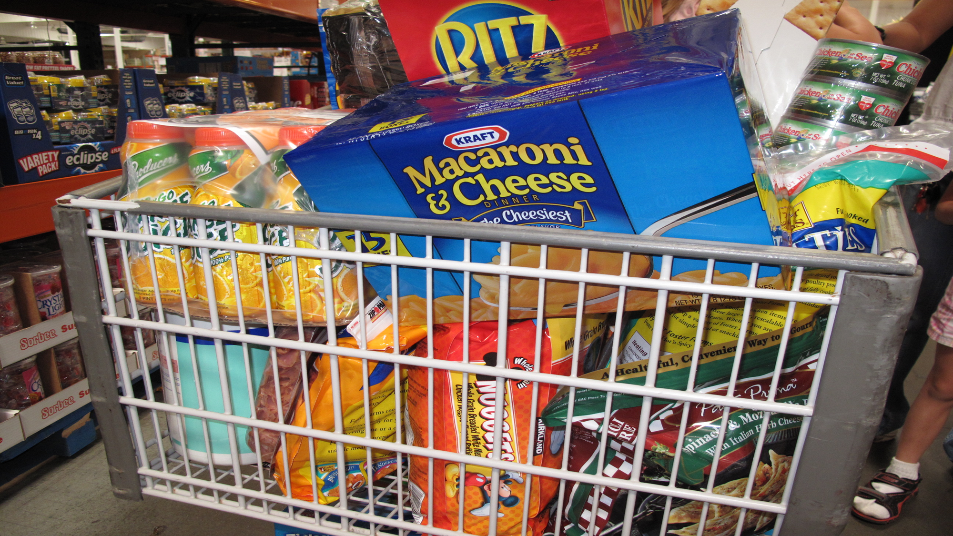
Anti-Inflammatory Diet

Slide 38
ENCORE: Ease Suffering
What is the difference between pain and suffering?

Slide 39
Pain vs Suffering
Pain is a physiological experience,
Suffering is a perception
Suffering is created by the way we think about time, threats, meanings, circumstances and stories

Slide 40
How can You Ease Suffering in Your Patient?
Encourage patients to anchor into the moment instead of using the past as a source of comparison and the future as a source of worry
Help patients to develop outlets for frustration like hobbies and exercise
Reframe the story as a story of survivorship and strength
Be present for your patient

Slide 41
Cultural Humility
“a lifelong commitment to self-evaluation and critique, to redressing the power imbalances in the physician-patient dynamic and to developing mutually beneficial and non-paternalistic partnerships with community on behalf of individuals and defined populations” (Tervalon and Murray-Garcia, 1998)

Slide 42

We also glory in our sufferings, because we know that suffering produces perseverance; perseverance, character; and character, hope
~Romans 5:3

Slide 43
How can we solve the epidemic?
How can we solve the epidemic of both chronic pain and OUD?

Slide 44
ENCORE can help you effectively treat pain and OUD
Evaluate the Pain
Neutralize the Nervous System
Core Strengthening
Open a Conversation
Restore Health
Ease Suffering

Slide 45
The Goal Is To…
Create a more deeply satisfying life
And restore HOPE

Slide 46
Thank you!
christinal@wsmcmed.org

